Slide 1
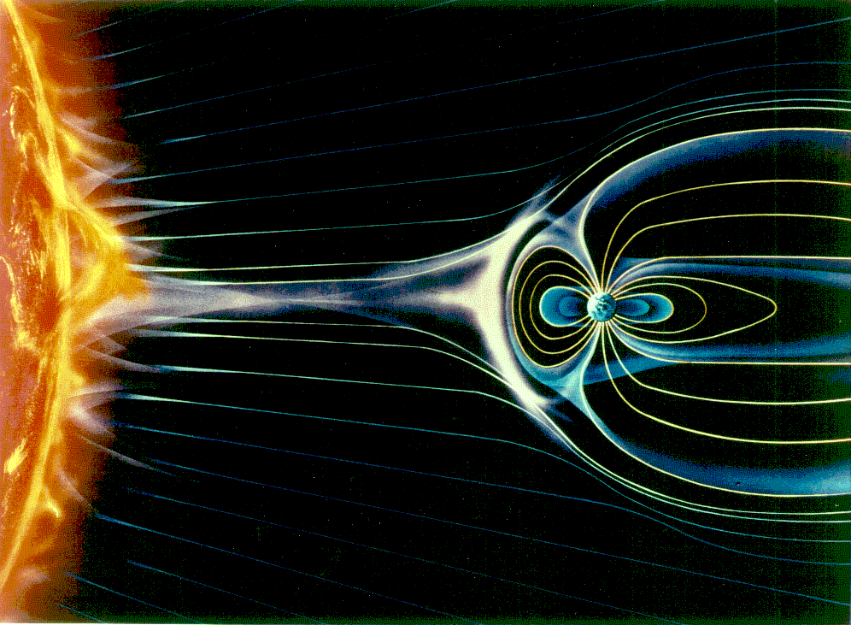
Magnetospheric Reconnection and Accelerated Flows
Claire Kuang
Mentor: Dr. David Sibeck
Basic Concepts
Current Theories
My Research and Results
Future Research

Slide 2
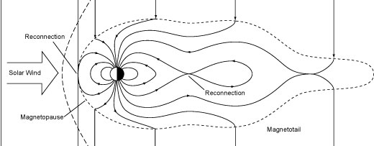
What is reconnection?
Occurs at the boundary of two different magnetic fields
Allows energy from the sun to penetrate the magnetosphere

Slide 3
Branches of Thought
Completely Predictable …
or Unpredictable!
B_{i}
“The direction of the line cannot be uniquely determined and may lie anywhere in the range of angles such that [components perpendicular to the line must reverse] is satisfied.” ~Cowley 1976
θ
B_{i}
B₀
“It is conceivable that solutions … exist with other orientations. But such solutions by necessity must display a peculiar asymmetry between the plasma ejections regions above and below the reconnection line.” ~Sonnerup 1974
θ
B₀
What can we learn from models?

Slide 4
My Research
Used models (through CCMC) to select and compare specific run conditions
Manually identified reconnection on the XZ plane
Plotted these data points to determine the line of reconnection
Compiled a database of runs and results for future reference

Slide 5
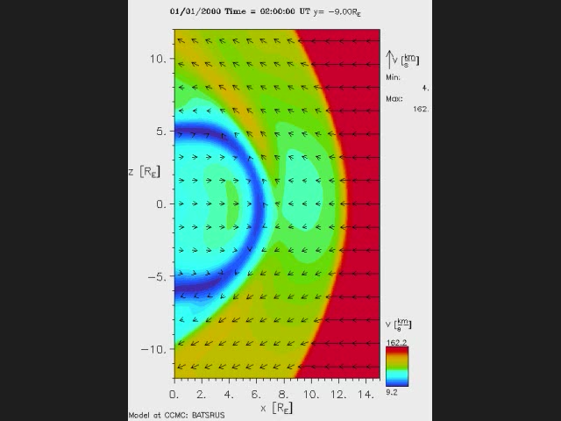
My Research

Slide 6
Preliminary Conclusions
The reconnection line tilts with respect to IMF angle in a predictable manner, though the exact degree varies with the parameters of each run.
The degree of tilt is noticeably affected by the strength of the IMF. Stronger IMF = larger tilt
IMF direction
Reconnection line
Fast flow direction

Slide 7
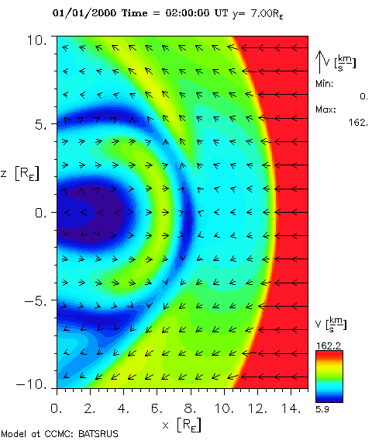
Sonnerup vs. Cowley
DID observe asymmetric flows above and below the reconnection line
Fulfilled Cowley’s requirement of flow reversal, and found consistent tilt angles (~95% similar across runs)

Slide 8
Further Research…
Continue to look at more runs for a more comprehensive picture of reconnection in models
OR
Why are there missing accelerated flows for certain runs?
Is the reconnection line actually a line?

Slide 9
Special thanks to…
Dr. David Sibeck
Dr. Hui Zhang
Intern coordinator Cori Quirk

